Slide 1
Forecasting Module Failures
Adam Pritchett

Slide 2
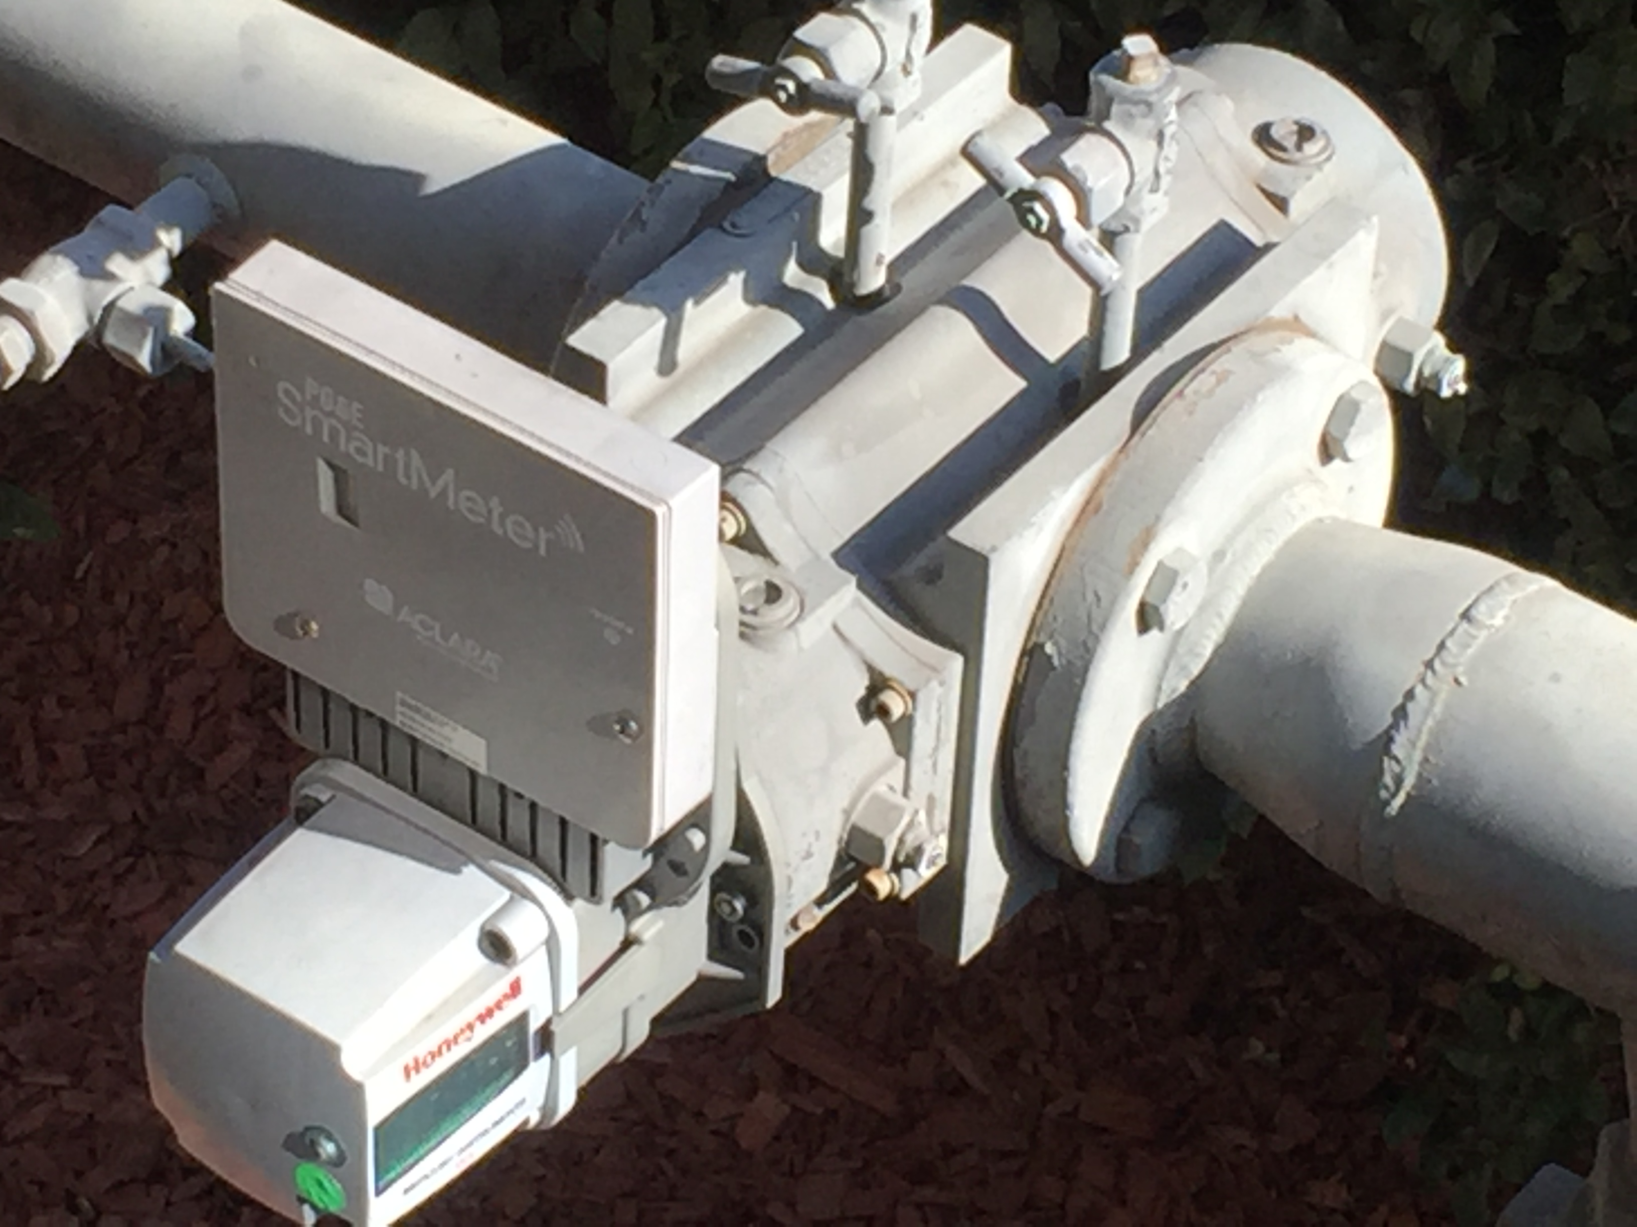
The problem
These modules are used to record gas usage. They’re failing at a higher rate. This created a need to forecast how fast they’re failing and how many people need to be brought in to fix them.

Slide 3
The data
There’s about 6 million modules in the dataset.
4.8M are still in use and we want to predict their lifespans.
We have install dates, geographic information, manufactures, removal dates (for those no long in service), mounting information.
All stored in an MS-SQL DB

Slide 4
Processing
Too many records to process all at once on my laptop and the data is sensitive, so I couldn’t just throw it onto AWS/Spark without clearing it through my internal IT security.
The solution is to do Monte Carlo simulations.
Batches of 10k records and ran them through several machine learning algorithms to determine which features were important. Took 8 runs to get a good convergence.

Slide 5
Feature Selection
After several runs through the models only 5 variables were consistently valuable and maintained low collinearity.
Age (makes sense there’s a battery)
Division (bigish geographic location)
Manufacturer
Mounting
Failure Month/Seasonality (Emergent and it fascinates me)

Slide 6
Models and Outcomes
Decision tree
A Neural network and a couple of deep learning models
Also put together a couple of traditional survival/hazard stats models
Results varied, some of which is probably the way the data was put in the model
They all caught the monthly flow though…

Slide 7
Other Models
The stats around lifecycles have some fairly standard survival/hazard mathematics used in both medicine and engineering.
There’s a PhD candidate at UCLA (Jared Kurtzman) and as part of his thesis he made a python package called deepsurv that uses the survival model statistics in a deep learning environment.
The big difference is that once a certain probability of failure is reached the model just labels a point as a failure w/o additional processing.
To really test things we built the final model on data ending in Dec 2018 to compare to actual results in 2019

Slide 8
Table of Results
Units | DT | NN | DL1 | DL2 | KM | COX | deepsurv | Actual
Jan-19 | 8451 | 5544 | 12801 | 11510 | 10446 | 10941 | 10799 | 10746
Feb-19 | 13062 | 8570 | 19925 | 16985 | 16568 | 16621 | 16365 | 16474
Mar-19 | 12009 | 7879 | 16133 | 15178 | 16295 | 14724 | 14921 | 14828
Apr-19 | 7596 | 4984 | 10318 | 10120 | 9798 | 9824 | 9847 | 9815
May-19 | 10193 | 6687 | 14759 | 13844 | 13091 | 12272 | 12254 | 12311
Jun-19 | 12725 | 8349 | 16512 | 15792 | 15269 | 15188 | 14922 | 14947
Jul-19 | 11891 | 7802 | 17533 | 15303 | 16107 | 15606 | 15411 | 15390
Aug-19 | 12999 | 8528 | 16875 | 16057 | 15897 | 15338 | 15215 | 15178
Sep-19 | 9544 | 6262 | 13866 | 14078 | 12759 | 12547 | 12725 | 12641
Oct-19 | 14552 | 9547 | 18953 | 17475 | 18818 | 17664 | 17925 | 17815
Nov-19 | 9980 | 6548 | 13605 | 12018 | 11788 | 12240 | 12155 | 12098
Total | 123002 | 80700 | 171280 | 158360 | 156836 | 152965 | 152539 | 152243
% Accuracy | NN | DL1 | DL2 | DL3 | KM | COX | deepsurv | Actual
Jan-19 | 79% | 52% | 119% | 107% | 97% | 102% | 100% | 100%
Feb-19 | 79% | 52% | 121% | 103% | 101% | 101% | 99% | 100%
Mar-19 | 81% | 53% | 109% | 102% | 110% | 99% | 101% | 100%
Apr-19 | 77% | 51% | 105% | 103% | 100% | 100% | 100% | 100%
May-19 | 83% | 54% | 120% | 112% | 106% | 100% | 100% | 100%
Jun-19 | 85% | 56% | 110% | 106% | 102% | 102% | 100% | 100%
Jul-19 | 77% | 51% | 114% | 99% | 105% | 101% | 100% | 100%
Aug-19 | 86% | 56% | 111% | 106% | 105% | 101% | 100% | 100%
Sep-19 | 76% | 50% | 110% | 111% | 101% | 99% | 101% | 100%
Oct-19 | 82% | 54% | 106% | 98% | 106% | 99% | 101% | 100%
Nov-19 | 82% | 54% | 112% | 99% | 97% | 101% | 100% | 100%
Total | 81% | 53% | 113% | 104% | 103% | 100% | 100% | 100%

Slide 9
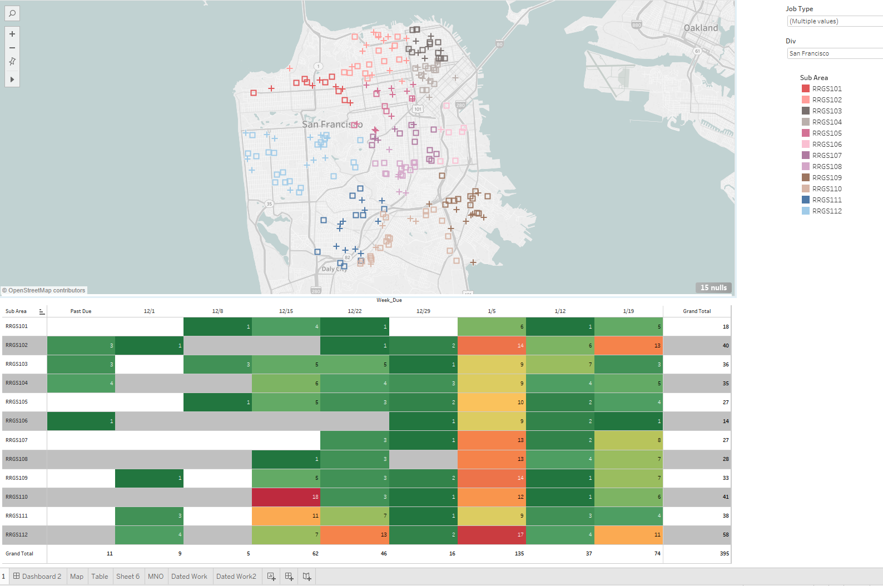
A little dashboard for the field
https://public.tableau.com/profile/adam3379#!/vizhome/FPGraphs/Sheet1?publish=yes

Slide 10
We made it to the end
We get our Saturdays back!
I’m happy and I’m proud of you
#teamdagger

